Slide 1
Operators and Expressions in Python

Slide 2
Operators are the constructs which can manipulate the value of operands.
Consider the expression 4 + 5 = 9.
Here, 4 and 5 are called operands and
+ is called operator.

Slide 3
Types of Operator
Arithmetic Operators
Comparison (Relational) Operators
Assignment Operators
Logical Operators
Bitwise Operators
Membership Operators
Identity Operators

Slide 4
Basic Arithmetic operators in Python
Command | Name | Example | Output
+ | Addition | 4 + 5 | 9
- | Subtraction | 8 - 5 | 3
* | Multiplication | 4 * 5 | 20
/ | True Division | 19 / 3 | 6.3333
// | Integer Division | 19//3 | 6
% | Remainder (modulo) | 19 % 3 | 1
** | Exponent | 2 ** 4 | 16

Slide 5
Order of Operations
Remember that thing called order of operations that they taught in maths? Well, it applies in Python, too. Here it is, if you need reminding:
1.parentheses ()
2.exponents **
3.multiplication *, division /, and remainder %
4.addition + and subtraction -

Slide 6
Order of Operations
Operator | Operation | Precedence
() | parentheses | 0
** | exponentiation | 1
* | multiplication | 2
/ | division | 2
// | int division | 2
% | remainder | 2
+ | addition | 3
- | subtraction | 3

Slide 7
The computer scans the expression from left to right,
first clearing parentheses,
second, evaluating exponentiations from left to right in the order they are encountered
third, evaluating *, /, //, % from left to right in the order they are encountered,
fourth, evaluating +, - from left to right in the order they are encountered

Slide 8
Example 1 – Order of operations
>>> 1 + 2 * 3
7
>>> (1 + 2) * 3
9
In the first example, the computer calculates 2 * 3 first, then adds 1 to it. This is because multiplication has the higher priority (at 3) and addition is below that (at a lowly 4).
In the second example, the computer calculates 1 + 2 first, then multiplies it by 3. This is because parentheses have the higher priority (at 1), and addition comes in later than that.

Slide 9
Example 2 – Order of operations
Also remember that the math is calculated from left to right, unless you put in parentheses. The innermost parentheses are calculated first. Watch these examples:
>>> 4 - 40 - 3
-39
>>> 4 - (40 - 3)
-33
In the first example, 4 - 40 is calculated, then - 3 is done.
In the second example, 40 - 3 is calculated, then it is subtracted from 4.

Slide 10
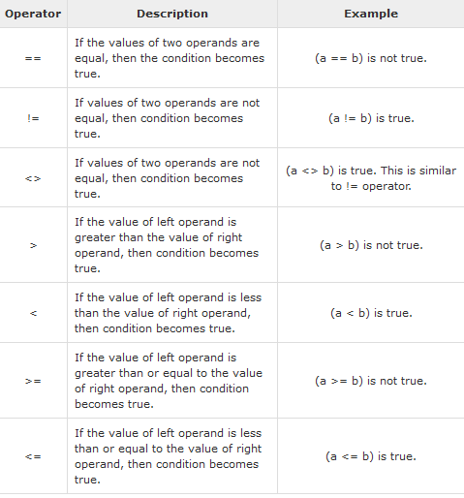
Comparison / Relational Operators

Slide 11
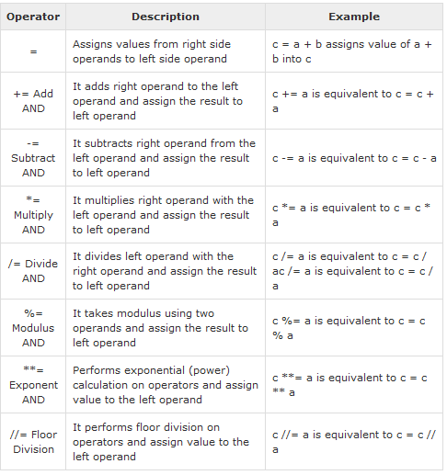
Assignment Operators

Slide 12
Bitwise Operators
Bitwise operator works on bits and performs bit by bit operation. Assume if a = 60; and b = 13; Now in binary format they will be as follows −
a = 0011 1100
b = 0000 1101
-----------------
a&b = 0000 1100
a|b = 0011 1101
a^b = 0011 0001
~a = 1100 0011

Slide 13
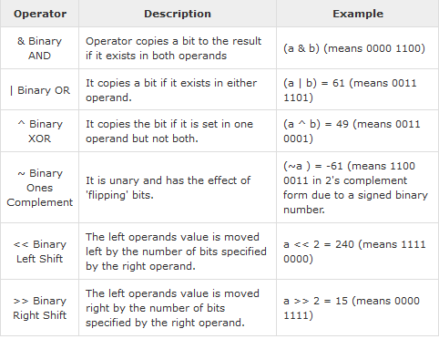
Bitwise

Slide 14
Bitwise Operations
This includes operators that treat integers as strings of binary bits, and can come in handy if your Python code must deal with things like network packets, serial ports, or packed binary data
>>> x = 1 # 1 decimal is 0001 in bits >>> x << 2 # Shift left 2 bits: 0100
4

Slide 15
>>> x | 2 # Bitwise OR (either bit=1): 0011
3
>>> x & 1 # Bitwise AND (both bits=1): 0001 1
In the first expression, a binary 1 (in base 2, 0001) is shifted left two slots to create a binary 4 (0100).
The last two operations perform a binary OR to combine bits (0001| 0010 = 0011) and a binary AND to select common bits (0001&0001 = 0001).

Slide 16
To print in binary format use bin function:
>>> X = 0b0001 # Binary literals
>>> X << 2 # Shift left 4
>>> bin(X << 2) # Binary digits string '0b100‘
>>> bin(X | 0b010) # Bitwise OR: either '0b11'
>>> bin(X & 0b1) # Bitwise AND: both '0b1'

Slide 17
Logical Operators
Assume a = 10 and b = 20
Operator | Description | Example
and | If both the operands are true then condition becomes true. | (a and b) is true.
Or | If any of the two operands are non-zero then condition becomes true. | (a or b) is true.
not | Used to reverse the logical state of its operand. | Not(a and b) is false.

Slide 18
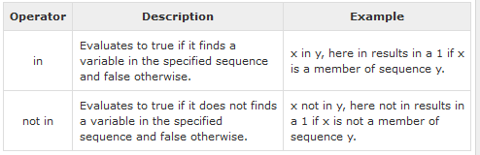
Membership Operators

Slide 19
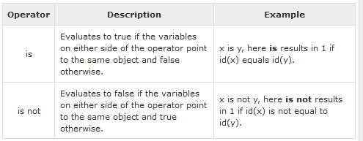
Identity Operators

Slide 20
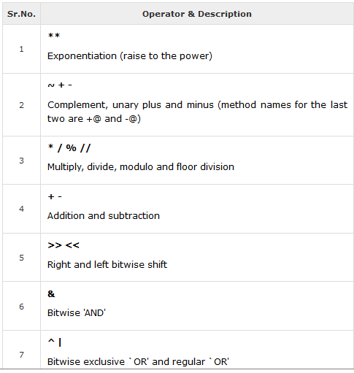
Operators Precedence

Slide 21
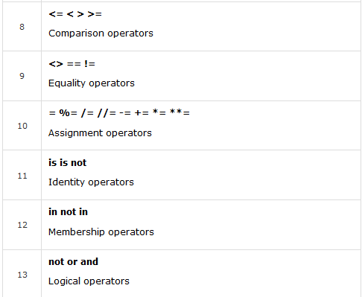

Slide 22
Quotation in Python
Python accepts single ('), double (") and triple (''' or """) quotes to denote string literals, as long as the same type of quote starts and ends the string.
The triple quotes are used to span the string across multiple lines. For example, all the following are legal −
word = 'word'
sentence = "This is a sentence."
paragraph = """This is a paragraph. It is made up of multiple lines and sentences."""

Slide 23
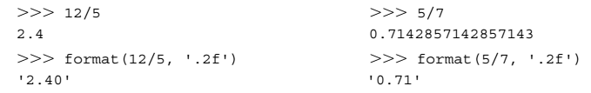
Built-in format Function
Because floating-point values may contain an arbitrary number of decimal places, the built-in format function can be used to produce a numeric string version of the value containing a specific number of decimal places.
In these examples, format specifier '.2f' rounds the result to two decimal places of accuracy in the string produced.

Slide 24

For very large (or very small) values 'e' can be used as a format specifier,

Slide 25
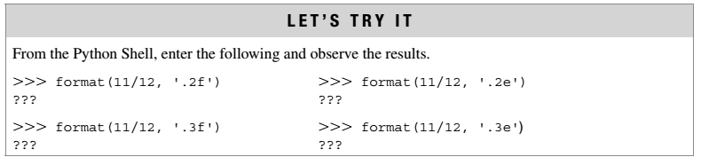

Slide 26

Python is a Dynamic Type language
Same variable can be associated with values of different type during program execution, as indicated below.
It's also very dynamic as it rarely uses what it knows to limit variable usage

Slide 27
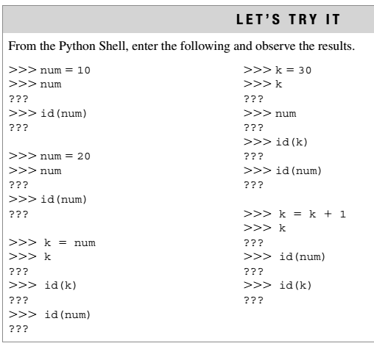

Slide 28
Python is a Strongly Typed language
interpreter keeps track of all variables types
Check type compatability while expressions are evaluated
>>> 2+3 # right
>>>”two”+1 # Wrong!!

Slide 29


Slide 30
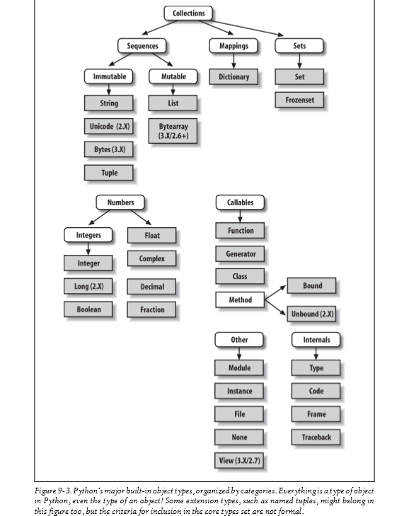

Slide 31
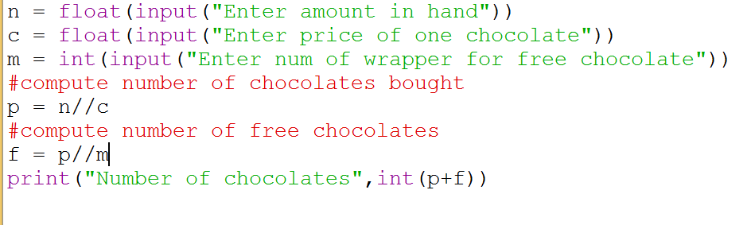
Python Program for Bob Problem

Slide 32
Problem -1
ABC company Ltd. is interested to computerize the pay calculation of their employee in the form of Basic Pay, Dearness Allowance (DA) and House Rent Allowance (HRA). DA and HRA are calculated as certain % of Basic pay(For example, DA is 80% of Basic Pay, and HRA is 30% of Basic pay). They have the deduction in the salary as PF which is 12% of Basic pay. Propose a computerized solution for the above said problem.
Input : Basic Pay
Process : Calculate Salary
( Basic Pay + ( Basic Pay * 0.8) + ( Basic Pay * 0.3 - ( Basic Pay * 0.12)
-----------allowances -------------- --- deductions----
Output : Salary

Slide 33
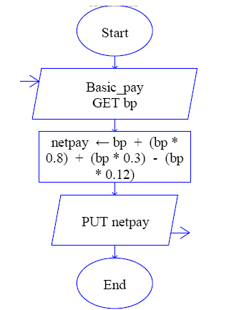
Flow chart

Slide 34
Python code
#Enter the basic pay
bp=float (input('Enter the basic pay:'))
# net pay calucluation
netpay =bp + (bp*0.8) + (bp*0.3) - (bp*0.12)
# display net salary
print ('Net pay :',netpay)

Slide 35
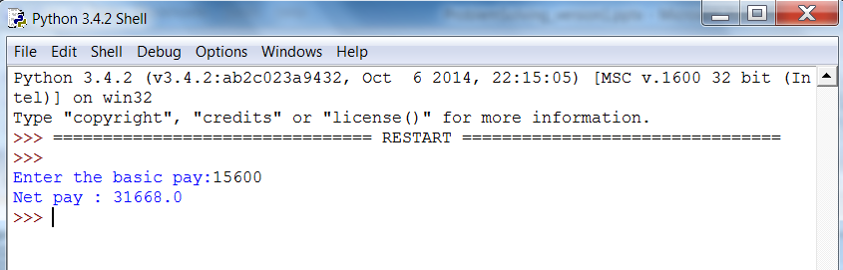
Output

Slide 36
Python features….. lambda operator
The lambda operator or lambda function is a way to create small anonymous functions, i.e. functions without a name.
ftoc =lambda f: (f-32)*5.0/9
print (ftoc(104))

